Slide 1
Gender Bias &
Perceived Aggressiveness
Karen Liang, Song Park, Kenneth Pong
W241 Final Project
April 16, 2021

Slide 2
Overview
Background
Women are underrepresented in the workforce.
“... 200 performance reviews within one company...the number of references to being “too aggressive” in the reviews… 76% of the instances were attributed to women, while only 24% of men were identified as having such a communication style.”
--Harvard Business Review
Our Hypothesis
There is a double standard on “aggressiveness” based on gender
Females are more likely to be perceived as aggressive
Notes:
Kenneth There have been many studies showing the underrepresentation of women in the workforce, especially in the technology domain. According to the recent study by McKinsey, for the sixth year in a row, women continued to lose ground at the first step up to manager. For every 100 men promoted to manager, only 85 women were promoted.
While remained significantly outnumbered in entry-level management at the beginning of 2020, women held just 38 percent of manager-level positions, while men held 62 percent.
In an article published by the Harvard Business Review [2], which looked at 200 performance reviews within one company, it revealed gender bias through the lense of performance review. The results tallied the number of references to being “too aggressive” in the reviews and, not surprisingly, 76% of the instances were attributed to women, while only 24% of men were identified as having such a communication style.
Does gender bias contribute to the perception of “aggressiveness” of a person? In another word, is there a double standard on “aggressiveness” in the workplace based on gender? I found this a very interesting research question that would potentially help us to get one small step closer to the bigger puzzle of the underrepresentation of women in the workforce.
Hi everyone, thanks for attending our W241 final project presentation. I’m Kenneth, and with me today is my teammate Song. We have a third teammate, Karen Liang, but she couldn’t be here today due to a family emergency. The subject of our presentation concerns the experiment we conducted on gender aggressiveness bias. To give a bit of quick background on why we chose the subject – we know that women are under-represented at mid- and senior levels in the workforce, with men holding 62% of manager-level positions. There are many reasons posited for this under-representation, but the most interesting one to us stuck out from a Harvard Business Review article, which reviewed gender bias across 200 performance reviews. Of all the references to excessive aggression in these reviews, 76% of them were attributed to women, which represents a substantial gender imbalance. A more famous example of strength in women interpreted as aggressiveness can be seen in the 2016 US election, when former Democratic presidential candidate Hillary Clinton was openly derided in a national debate as “a nasty woman”. Taken together, these hint at a double standard on how aggressiveness is perceived based on the person’s gender.

Slide 3
Research Question:
Does gender play a role in the perceived level of aggressiveness of an individual?
Notes:
Kenneth
Therefore, we set out to test the hypothesis that there is an underlying gender bias contributing to how aggressive a person is perceived to be. Specifically, the literature suggests that, all other things equal, a scenario seeing a woman undertake the same actions as a man would see the woman be perceived to be more aggressive than the man, with the only variable being the gender of the person undertaking the action.

Slide 4
Experiment Design - Story & Character Names
Picking the story
Common workplace scenario: compensation
Noncontroversial, relatively neutral language
Picking character names
Female version - Kelly, Male version - Kevin
Obviously male and female names
Sentiment neutrality
Notes:
Kenneth
To test this hypothesis, we set up a straightforward experiment. The core of the experiment was delivered in the form of a short story involving some conflict between two parties – an employee asking for a raise, and their manager. The treatment of this experiment was delivered through the gender of the protagonist – in treatment, they would be a female character, whereas in the control, they would be a male character. Development went through several iterations of the story until we came up with something we were satisfied would be perceived as aggressive, but not overly aggressive so as to leave some room at the top of the scale for the hypothesized gender aggressiveness bias to manifest.
The very short version of the story is this: The protagonist meets with their manager to ask for a raise of 15%. At first, the manager is impressed by the protagonist’s efforts and work, but when the request for a raise is made, the request is denied. The protagonist presses their position harder, but this act is rebuffed by the manager. In this story, the primary source of aggressive behaviour consists in the part where the protagonist presses their position despite having been declined.
In order to reduce the possible variation in scores, we kept the story identical in both treatment and control, aside from the gender of the protagonist. Another source of variation we controlled for was in the name of the protagonist, as we believed that some names would be subject to pre-existing sentiment which would cause us to misestimate the hypothesized effect size. To account for this, we took a list of the 100 most common male and female names kept by the US social security administration, and used sentiment analysis in the form of GloVe embeddings to determine the sentiment scores of each, with the aim of selecting names with the gender sentiments closest to zero. Through this process, we determined that the treatment and control protagonist names should be Kelly and Kevin, respectively. The third-place male name, Sean, was used for the manager’s name, as we had to skip over the second-place name (Ronald) due to possible conflation with Donald, which had the second lowest sentiment score out of the 100 common male names.
Recruiting was done over Amazon Mechanical Turk, and the survey was administed via Qualtrics. At this point, I’ll let Song go into more detail about how the study was set up logistically, as well as the measurements we used to conduct our analysis. Song?

Slide 5
Experiment Design - Overview
Mechanical Turk to recruit participants
Qualtrics survey
Demographic questions
Short story describing a workplace scenario (~500 words)
Questions about the story (combat non-compliance)
Questions about the level of aggressiveness of the characters in the story
Notes:
Song

Slide 6
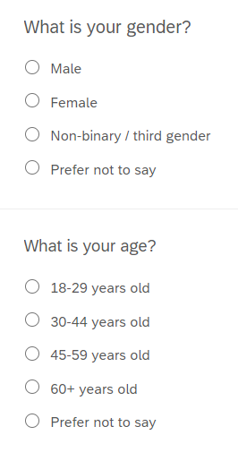
Random Assignment
Blocking on age group & gender - 20 blocks
Within each block, participants randomly presented with the story where the main character is either male or female
50%
Male version of story (Kevin)
For each gender x age group combination
50%
Female version of story (Kelly)
Notes:
Song For random assignment of the treatment, we first blocked on age group & gender. Based on the responses to the demographic questions in the first part of the survey, which you can see the response options to those questions on the right, there are a total of 20 blocks. Within each block, participants are randomly presented with either the male version of the story or the female version of the story

Slide 7
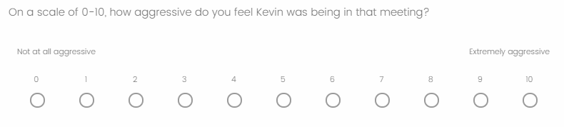
Survey Responses
832 total submitted surveys
Main outcome variable
Notes:
Song For our final study, we had 832 total submitted & complete surveys. Our main outcome variable is the questions below, which says on a scale 0-10, how aggressive do you feel Kevin was being in that meeting? This is the male version of the survey, and of course the female version asking the same questions just with Kelly instead of Kevin.

Slide 8
Respondent Demographics
Age Group | # | %
18-29 | 220 | 26.4%
30-44 | 366 | 44.0%
45-59 | 166 | 20.0%
60+ | 77 | 9.3%
Prefer not to say | 3 | 0.4%
Education | # | %
Less than high school degree | 6 | 0.7%
High school graduate (high school diploma or equivalent including GED) | 152 | 18.3%
Associate degree in college (2-year) | 100 | 12.0%
Bachelor's degree in college (4-year) | 395 | 47.5%
Master’s degree | 155 | 18.6%
Doctoral degree | 15 | 1.8%
Professional degree (JD, MD) | 9 | 1.1%
Gender | # | %
Male | 413 | 49.6%
Female | 410 | 49.3%
Non-binary/third gender | 4 | 0.5%
Prefer not to say | 5 | 0.6%
Notes:
Song

Slide 9
Block Sizes
 | Female | Male | Non-binary/ third gender | Prefer not to say
18-29 | 109 | 109 | 1 | 1
30-44 | 164 | 198 | 3 | 1
45-59 | 90 | 75 | 0 | 1
60+ | 46 | 31 | 0 | 0
Prefer not to say | 1 | 0 | 0 | 2
Notes:
Song

Slide 10
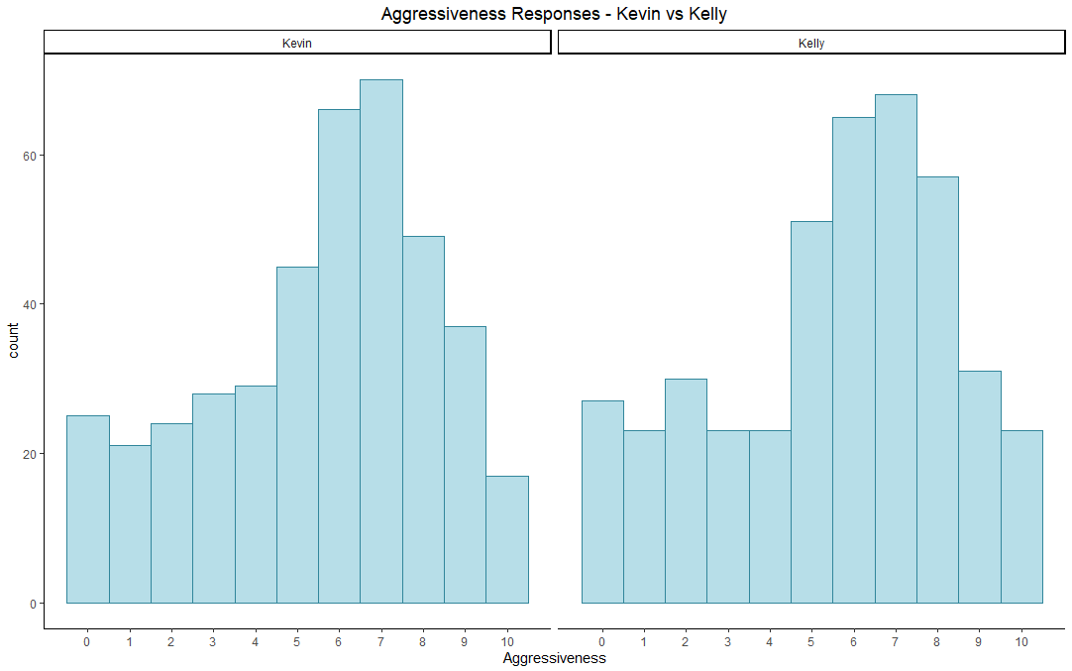
Aggressiveness Responses - Kevin vs Kelly
Mean 5.535
Mean 5.534
Notes:
Song To get a feel of what the responses are like before actually running models, I’m going to go through a few slides that just show the distribution of the responses to the aggressiveness question.

Slide 11
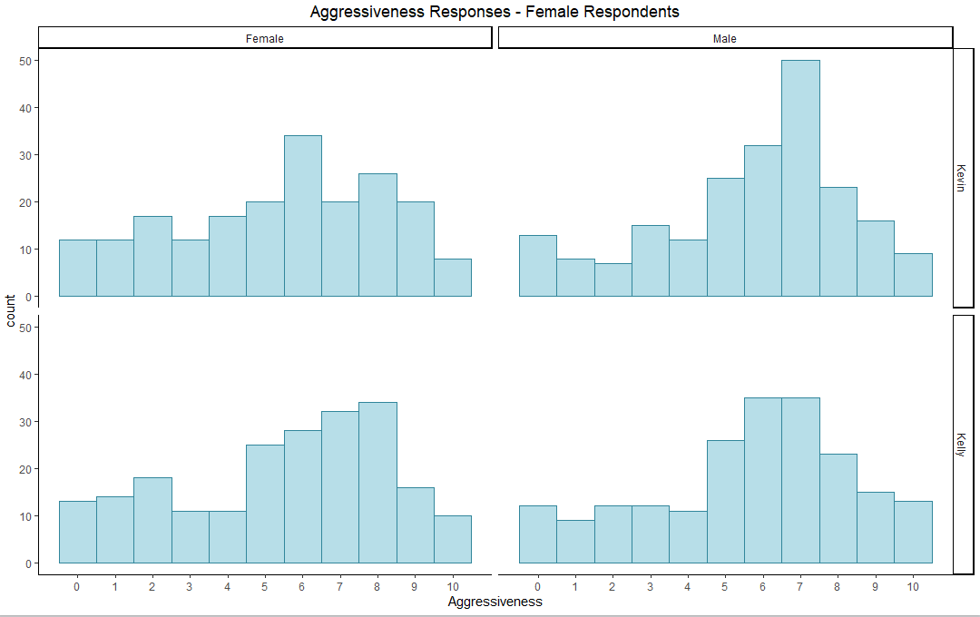
Aggressiveness Responses - Female vs Male Respondents
Mean 5.364
Mean 5.714
Mean 5.472
Mean 5.650
Notes:
Song

Slide 12
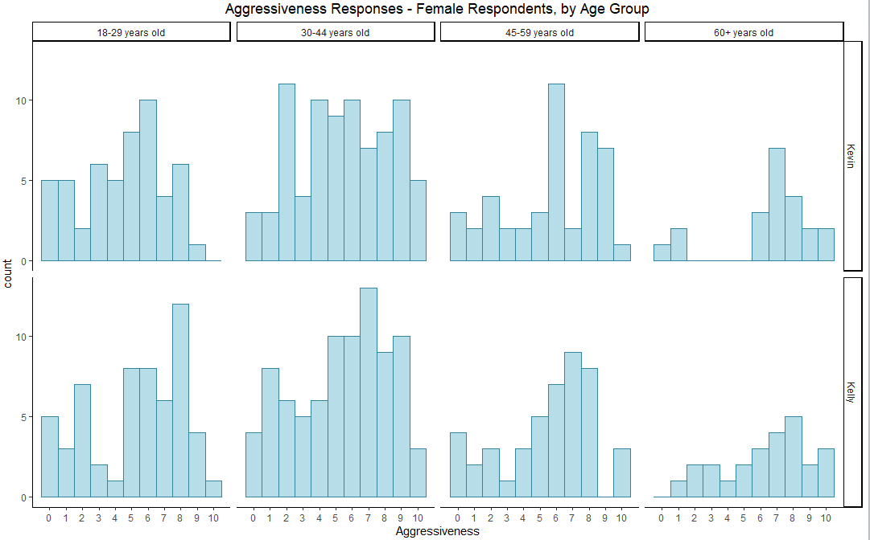
Aggressiveness Responses - Female Respondents by Age
Mean 4.462
Mean 5.438
Mean 5.689
Mean 5.619
Mean 5.246
Mean 5.381
Mean 5.499
Mean 5.360
Notes:
Song

Slide 13
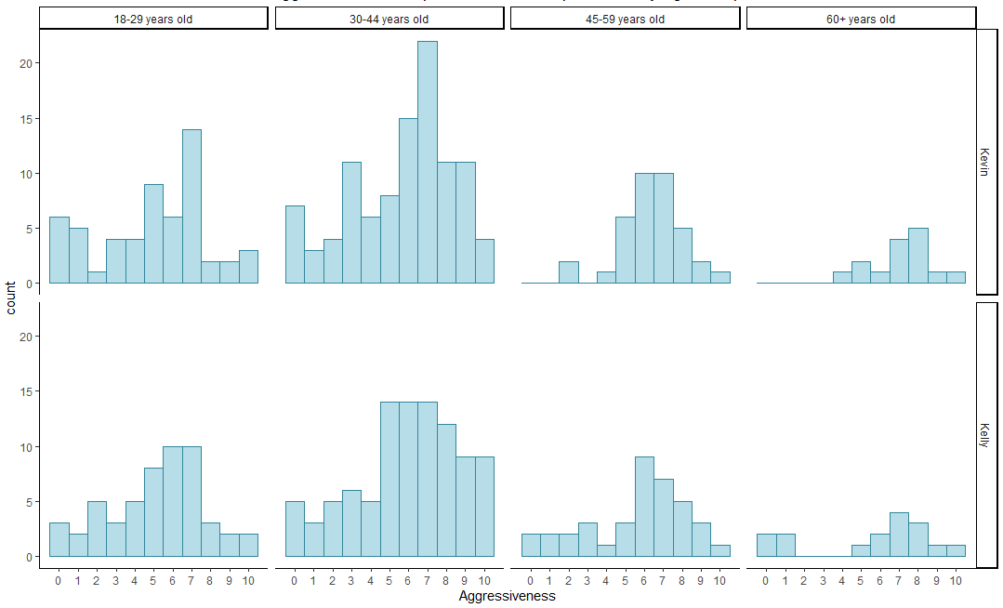
Aggressiveness Responses - Male Respondents by Age
Mean 4.964
Mean 5.676
Mean 6.378
Mean 7.133
Mean 5.151
Mean 5.938
Mean 5.632
Mean 5.625
Notes:
Song

Slide 14
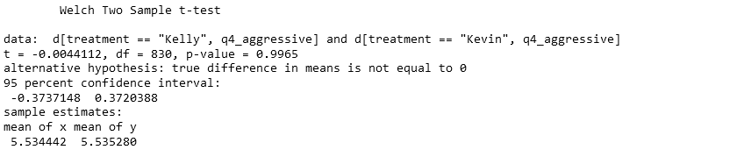
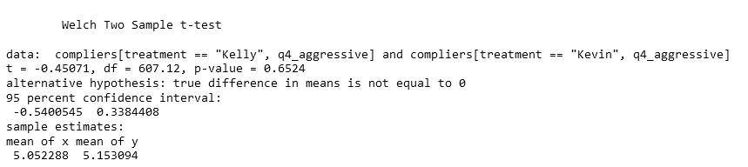
Preliminary Results T-Test
Notes:
Kenneth
- Thank you, Song. Let’s move onto the preliminary results of our study. I also wanted to add that we hosted our analysis on an RStudio Cloud instance, which gave us the ability to collaborate on the analysis we did, and to see exactly how our teammates conducted their analyses. We started with a naïve check of the values returned to us as part of the main study, and ran independent samples t-tests on both of them, with and without regard to compliance. In both cases, we made two directionally consistent observations, which unfortunately do not bode well for our initial hypothesis. Simply put, there were no statistically significant difference in the aggressiveness scores between treatment and control. What’s more, the point estimates, though not statistically significant, actually indicated that in the confines of this presentation format and story, men were actually seen to be slightly more aggressive, all other things equal, which was what Song alluded to earlier. This means that the average treatment effect we got back is actually negative. Of course, the analysis we conducted means that we have insufficient evidence to reject the null hypothesis either way, but neither the strength of the p-values nor the relative positions of the point estimates appear to favour our hypothesis.
Of course, we still want to investigate in greater depth – specifically, we still want to look at the possibility of heterogeneous treatment effects across the different age, education and gender groups, in order to follow through with our original intentions. Still, the preliminary results give us an indication of what we can expect, and the results are frankly not great for the hypothesis we started with. At this point, we’re primarily looking for differences between blocks as a way of identifying potential avenues for follow up research.

Slide 15
Limitations
MTurk and Recruiting
Generalizability of results?
Imperfect ability to measure noncompliance
Delivery mechanism
What if it was a video? A social media post?
Difficulty in quantifying treatment dosage
Duration of “dosage” too brief?
Notes:
Kenneth
At this point, it’s important to point out that we are aware of many of the limitations of this study. Foremost among them are the method by which we recruited participants. Our respondent group was drawn exclusively from Mechanical Turk, and the timeframes in which we drew respondents were fairly short. This raises questions about the generalizability of the study, as well as restricting the respondents to a small demographic group of relatively tech-savvy, predominantly white subset. The nature of the study conducted means these results are primarily Anglocentric in nature, and may not reflect views held in other cultures as well. Though we are confident that the randomization was delivered properly by the tools we used, we also understand that the respondents we drew on are unlikely to be similar in composition to the samples drawn on in more rigorous research.
This also raises the issue of the quality of our noncompliance metrics. We have taken multiple measures to identify noncompliance, in ways that are both visible and invisible to the end users – however, we recognize that these are imperfect metrics, and we are unable to perfectly identify everyone who decided to try to zip through the story without actually paying attention.
Another limitation is in the delivery method of the treatment. The medium we chose was in the form of a short story. This is admittedly a pretty narrow scope to test in. Would the result have been different if the story was delivered in another medium? For example, if we had delivered the story in the form of a video, would the format have further accentuated the differences exhibited by gender? Perhaps a richer medium would have more yielded a stronger treatment effect.
On that note, the treatment dosage as it was set up in this experiment has been something that is difficult to quantify. While the treatment itself is very clear (i.e. writing a story with varying protagonist genders), the strength of the treatment is hard to assign a number to, as writing is qualitative in nature. As well, the story itself exists in a vacuum, where the readers have no prior context of what the characters are like. It’s possible that an effect requires people to know the characters more personally and/or for longer before it manifests, which is unfortunately beyond the scope of this experiment. We also have limited information on what, if any mediators may be leading to this effect.

Slide 16
Questions/Feedback?
Notes:
Kenneth
For now, this concludes our presentation – thank you for your time. We would be happy to address any questions about our experiment.

